Slide 1

Remdi
Stop Piracy, Support Creativity

Slide 2
About Remdi
Redmi is an emerging start up which,
-> is against movie Piracy
-> prohibits recording the movies in theatres
-> emphasizes on common website for movie downloads to rise revenue for the film makers and producers
-> reduces the paid reviewers and reviews for a film

Slide 3
Problems raised due to movie piracy
It creates a huge loss for producers and the movie distributors
It destroys the dream of the film maker and the people who is dependent on the film
On the whole, The whole effort of the movie crew goes in vain

Slide 4
How Remdi profits
The producers
->A centralised Governmental website to download movies, through which we can provide revenue to producers, after the producer of the movie approves which reduces people to look on for privacy websites
The theatre owners
-> we can use aadhaar Verification for individual ticket booking and for watching movie

Slide 5
How Remdi works
While screening the movie in theater we can use invisible water mark of Theater name and its id in the screen.
If the movie is being captured in the theatres, and is uploaded on the internet , a screen shot of a movie will be used to reveal the invisible water mark , which results in finding out from which theatre the movie is captured and severe action will be taken against the theatre owners

Slide 6
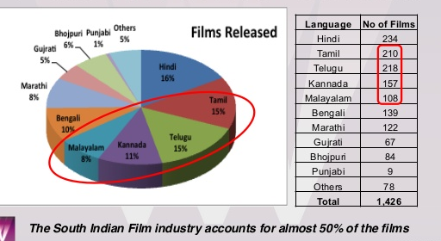
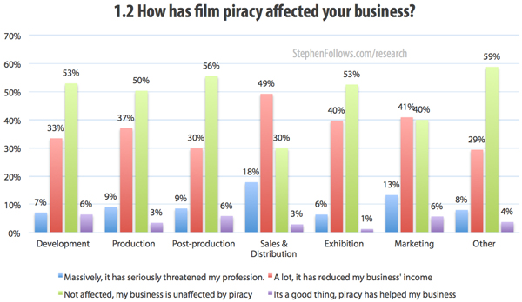

Slide 7
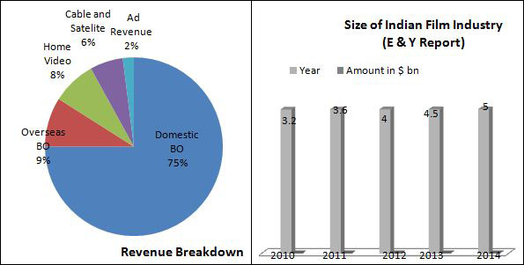
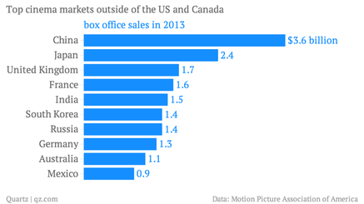

Slide 8
Benefits
We can rise revenue
To reduce movie piracy rate
Employment can be increased
We can increase cine markets then other countries
Reduce illegal ticket buying, more development to Cine industries

Slide 9
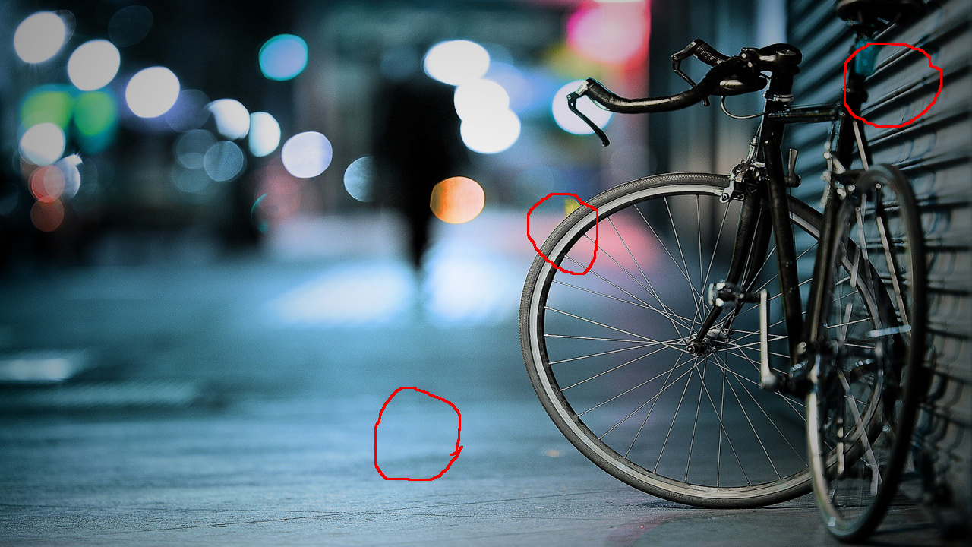

Demo

